Slide 1

AutonOmous Car

Slide 2

Team:
Christoph Griesbeck
Christoph WinterW
Fabian Schurig
Ioannis Stratakos
Laurie Marceau
Roger Rösch
Valentin Novak
Yushen Zhang

Slide 3

Goals:
Fully autonomous driving
Localization and navigation
Compliance with traffic signs
Compliance with traffic lights
Obstacle avoidance
Following lines

Slide 4
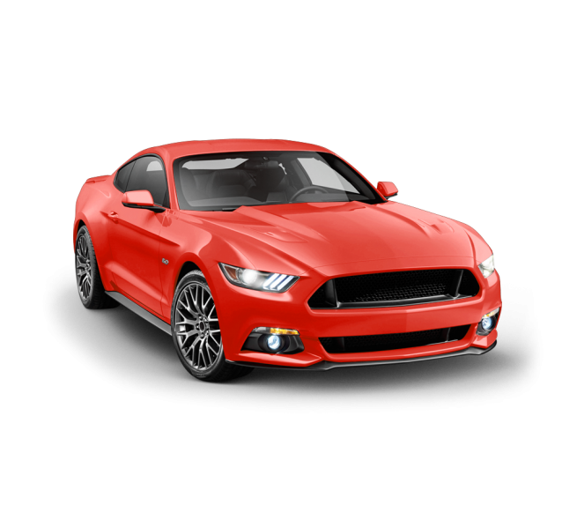
Car:
Four wheel drive
Front and rear differential
Four independant suspension
High speed (very)
Two servo motors for steering
One big motor for driving

Slide 5

System:
DE0-NANO FPGA Development Board
Sabre Lite i.MX6 Development Board
Two Ultrasonic Sensors
Logitech Quickcam Pro 9000
Homemade 3D stereo camera
GPS module

Slide 6
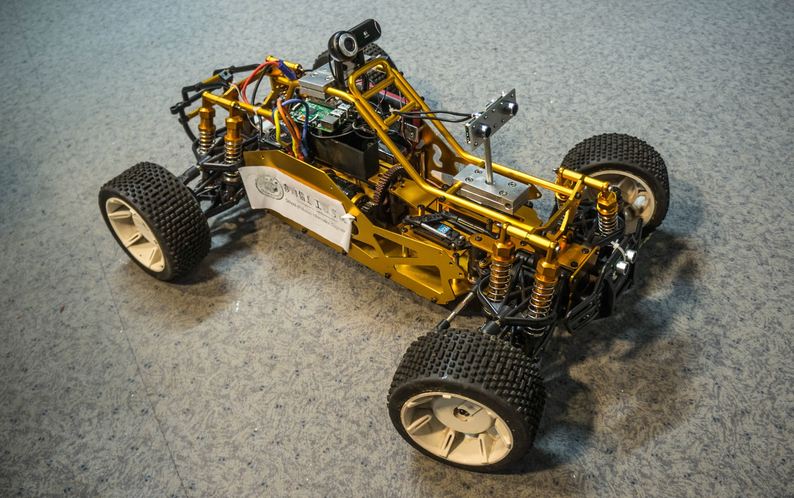

Slide 7
Progress – System (Roger)
Compiled u-boot
Compiled Kernel
Setup phython server
Compiled OpenCV
Got OpenCL running
Raspberry Pi
Recording (FFMPEG)

Slide 8
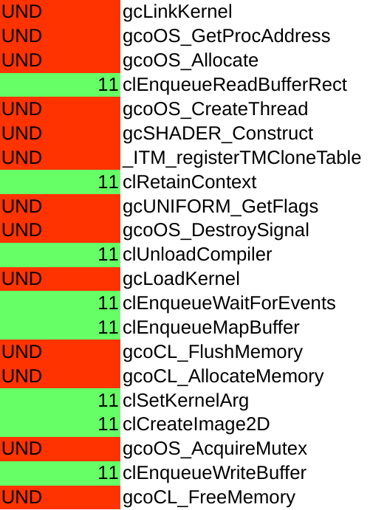
Progress – OPENCL
/usr/lib/libOpenCL.so:
undefined symbol: gcoOS_AtomConstruct

Slide 9
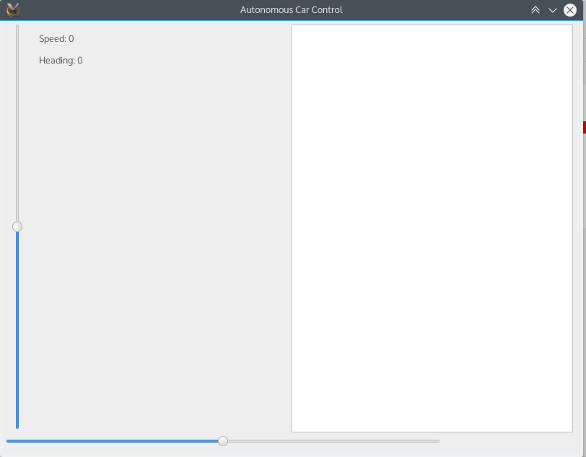
Progress – controling the car:
FPGA <-> i.MX6 <-> PC GUI
Pwm (steering and acceleration)
Open loop regulation

Slide 10

Progress – mechanical
Mounts
Wires and connectors
Cable managment

Slide 11
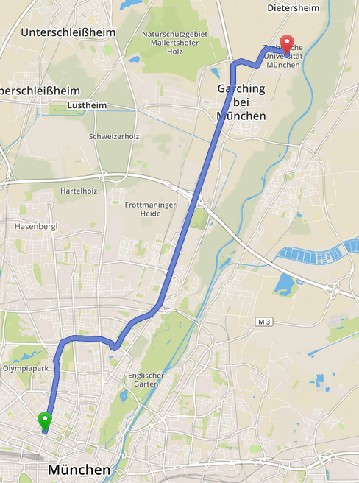
Progress – GPS:
GPS reading (FPGA)
MAPS (Open street map)
Navigation (Osrm)

Slide 12
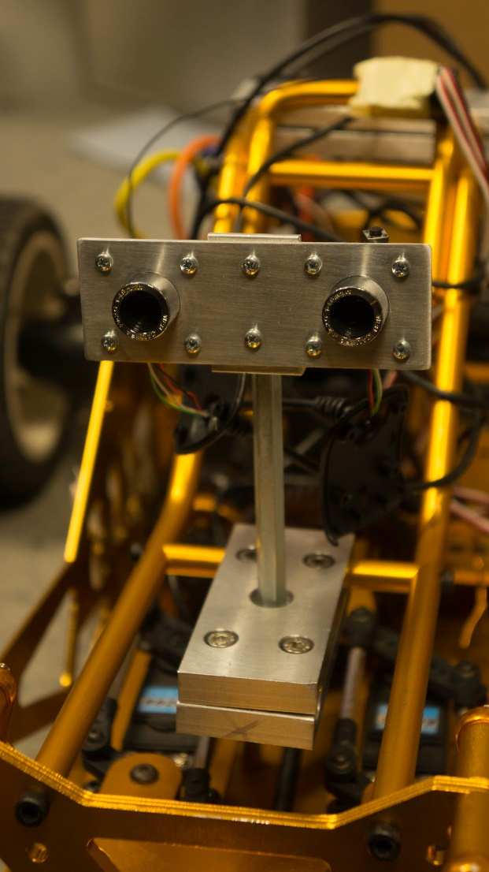
Progress – Cameras:
Logitech (For traffic signs)
stereo (for lanes and obstacles)
320x240
25 FPS (Right light)
FFMPEG

Slide 13
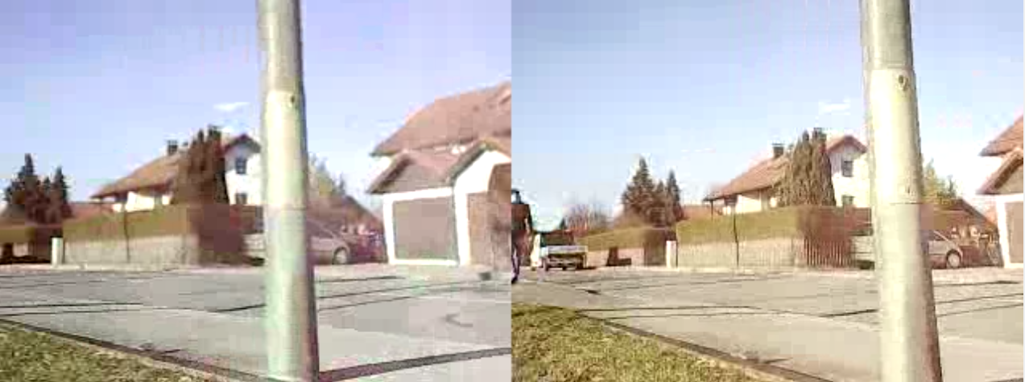
Progress – Cameras:

Slide 14
Traffic Sign Detection - PROCEDURE (Christoph & Christoph)
Get the picture to analyse
Use HSV filter to select the relevant parts (e.g. red)
Use Canny alghorithm to detect edges
Apply findContours to get the shapes
Choose the relevant shapes
Check their properness in regard to possible signs
Return the located signs and their position

Slide 15
Traffic Sign Detection – MILESTONES
Detect Stop signs
Detect priority signs
Detect red triangles (yield sign and warning sign)
Future - Get orientation of triangles
Future - Detect speed signs

Slide 16
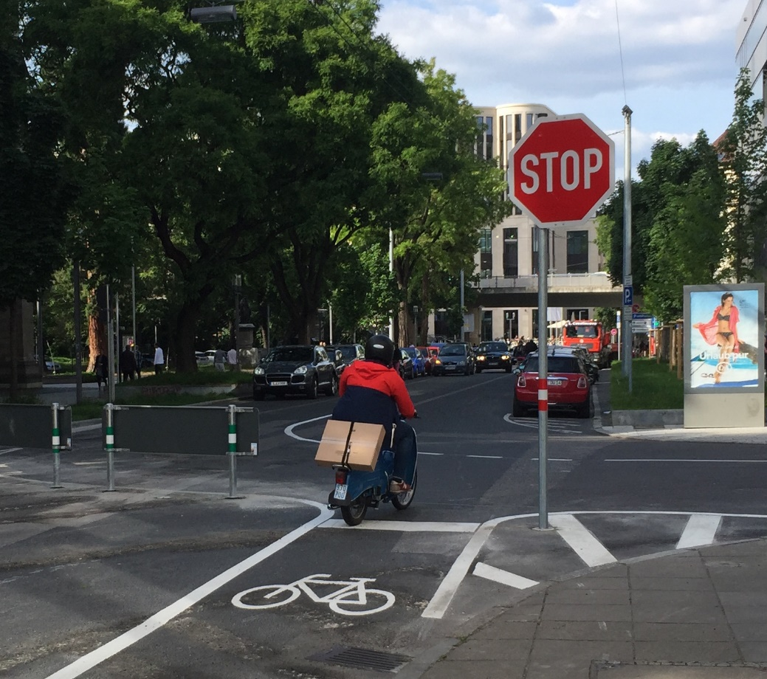
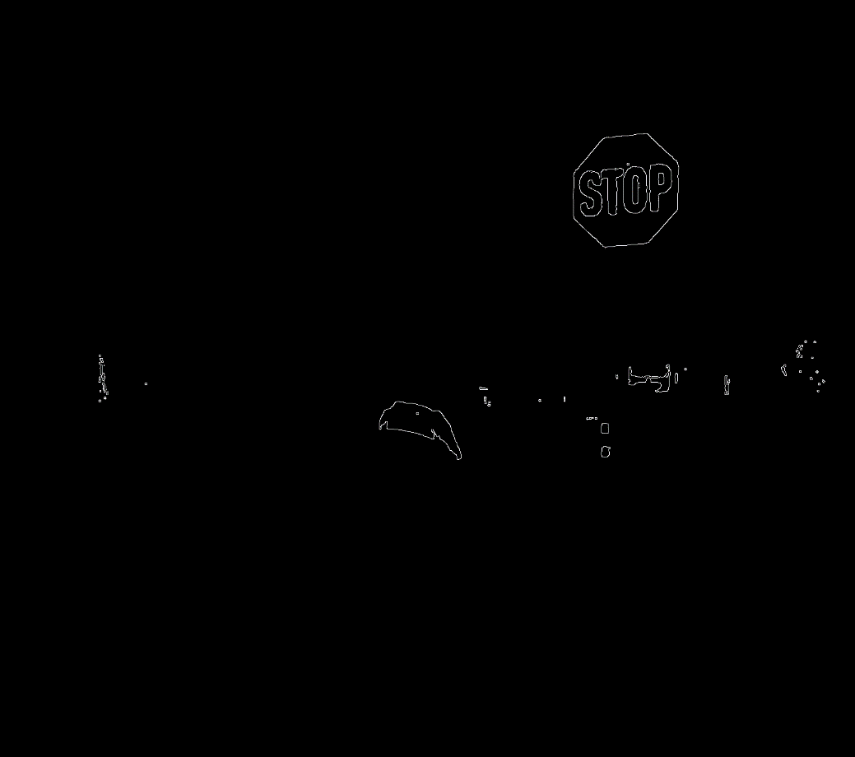
Traffic Sign Detection - RESULTS

Slide 17
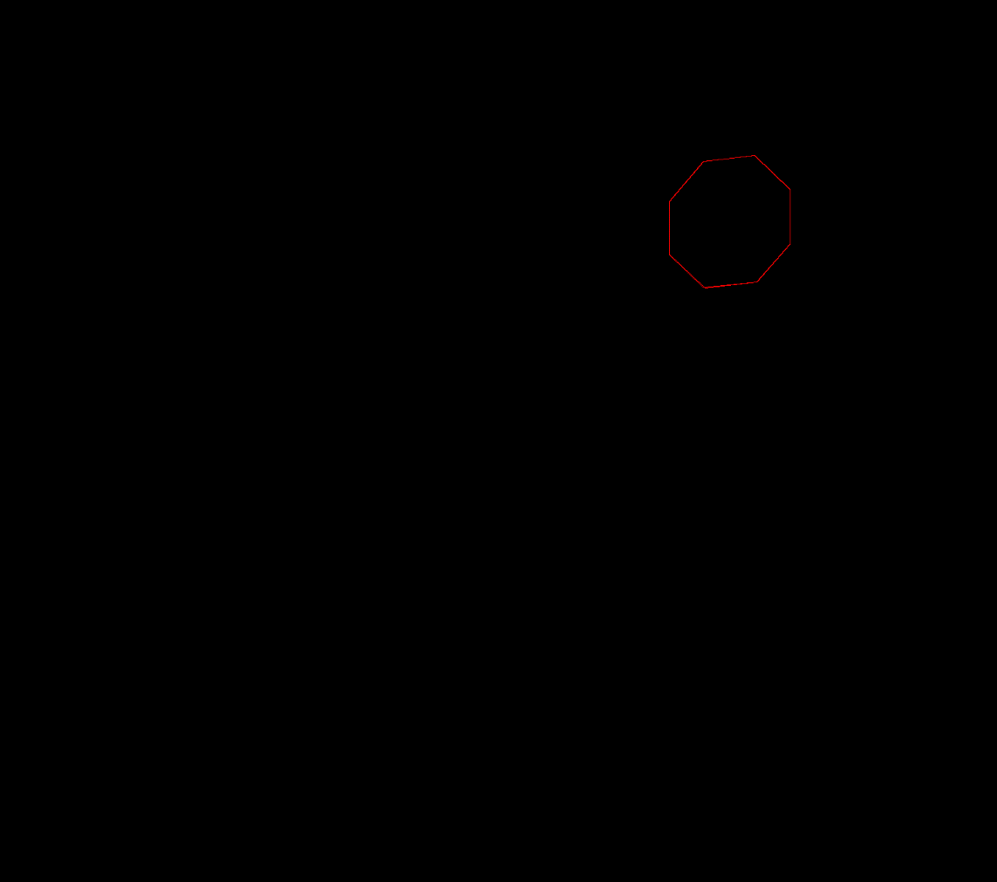
Traffic Sign Detection - RESULTS

Slide 18
Line Detection - PROCEDURE (Fabian)
Get live video feed through LMS
Convert to Grey Image
Define region of interest 320x100
Use Canny Algorithm to detect edges
Find Contours with OpenCV
Approximate Polylines with Douglas Peucker Algorithm
Draw and output start and end points from each approximated polyline along the edge of a lane

Slide 19
Line Detection – Missing
Interpretation of found polylines
Filter out everything except lanes
foresighted lines (looking ahead lines)

Slide 20
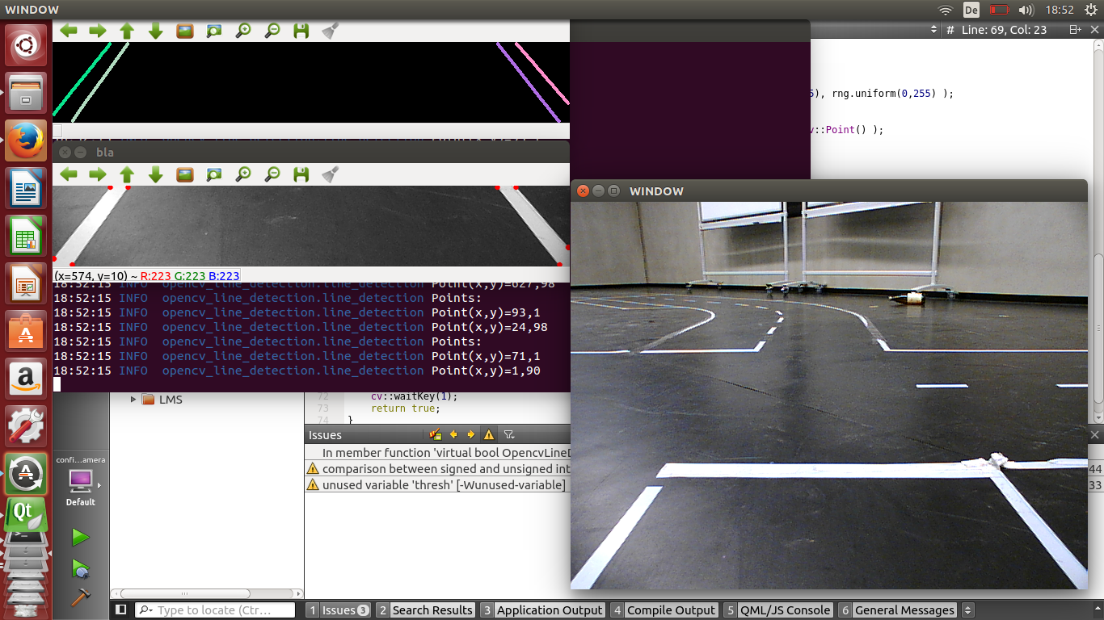
Line Detection – RESULTS

Slide 21

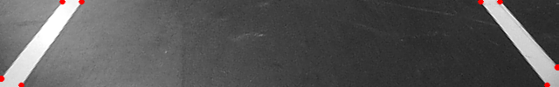
Line Detection - results
Polyline 1: Point(x,y)=586,1 Point(x,y)=638,61
Polyline 2: Point(x,y)=562,1 Point(x,y)=638,97

Slide 22
Progress – Traffic Light Detection (Ioannis)
Calibration (Exact range of colors)
Transformation to HSV
Filter red, yellow and green
Locate circles (Hough algorithm)

Slide 23
Progress – Issues and solutions
Car lights detected (Process only upper part)
Roads are not flat
Detecting non circular lights (vision algorithms)
Red and yellow light (experiment and optimization)

Slide 24
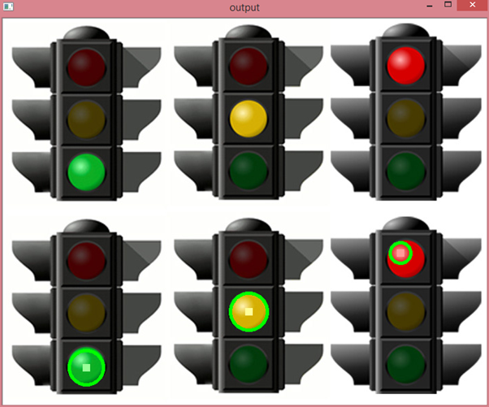
Traffic Light Detection - Results

Slide 25
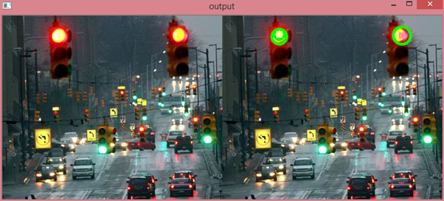
Traffic Light Detection - Results

Slide 26
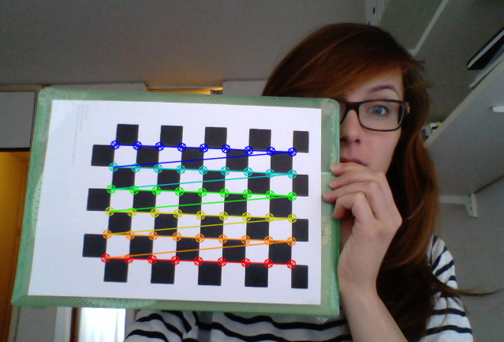
Stereo Vision - PROCEDURE (Laurie)
Intrinsic calibration of camera

Slide 27
Stereo Vision - PROCEDURE
Take picture
Remove distortion
Calculation of stereo dispartiy
Block matching algorithm

Slide 28
Stereo Vision - Improvements
Real stereo camera
Extrinsic camera calibration
Real time depth mapping

Slide 29
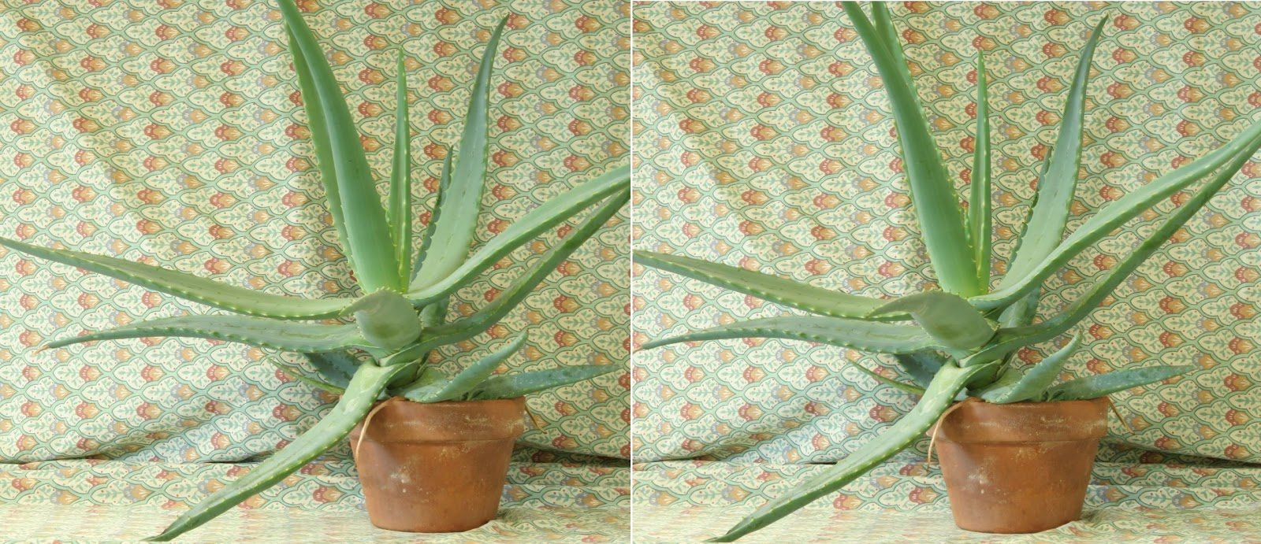
Stereo Vision - RESULTS

Slide 30
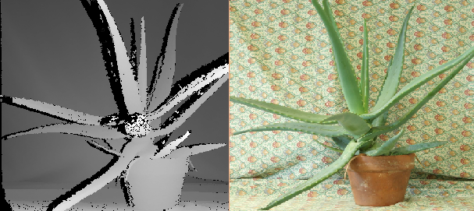
Stereo Vision - RESULTS

Slide 31
FUTURE WORK - odometry
Encoder (hard to install)
Inductive proximity sensor

Slide 32
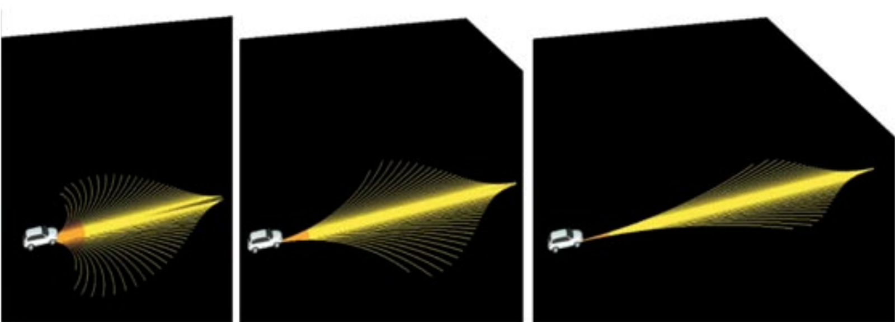
FUTURE WORK - TENTACLES
Has to be very fast
Has to adapt to car speed and properties

Slide 33


